Slide 1
Overview Anush Devadhasan

Slide 2
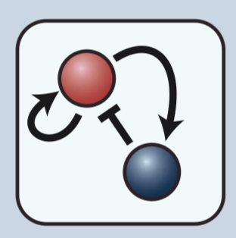
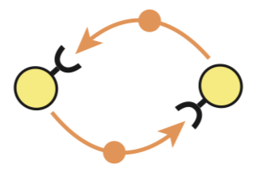
Turing Model vs Cellular Automaton
Turing Model | Cellular Automaton
Two chemical species | One chemical species
Both positive and negative reinforcement | Only positive or negative reinforcement
Diffusion over continuous field | Discrete lattice
2-dimensional | Torus
 | Periodic Boundary Conditions

Slide 3
Dynamics
Turing Model | Cellular Automaton
Continuous time-varying cell states | Discrete time-varying cell states
Interacting Ligands | Non-interacting Ligands
Spatially unconstrained diffusion | Diffusion restricted to nearest neighbors

Slide 4
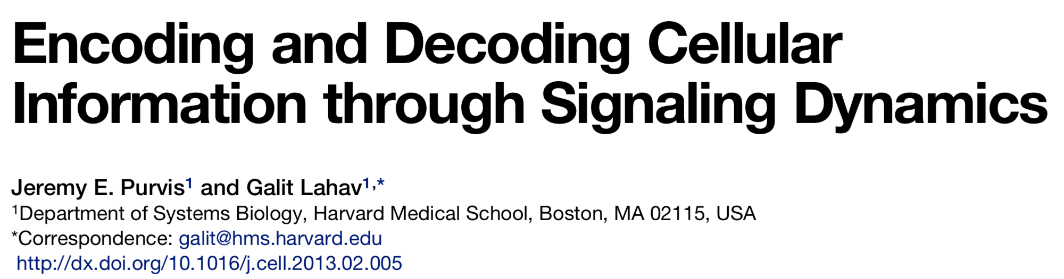
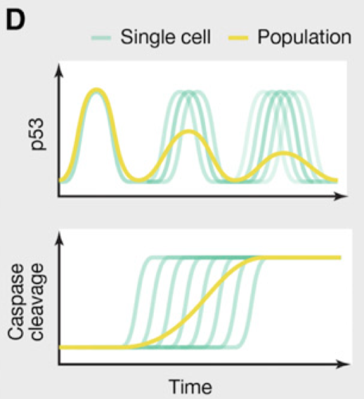
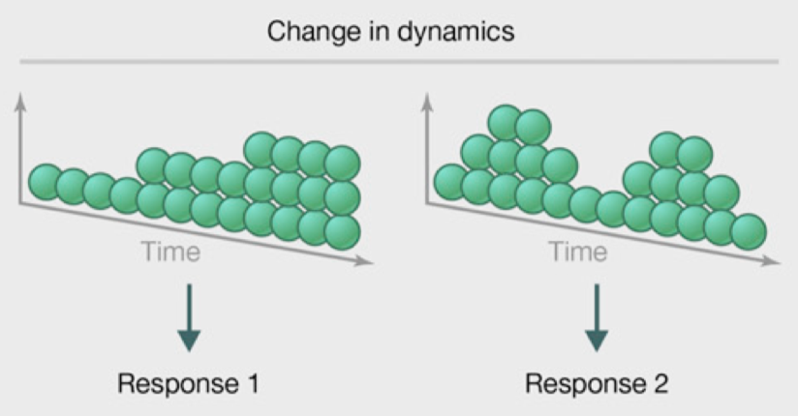
Temporal Biological Signaling
Cells are capable of generating signals that encode downstream responses in their temporal dynamics.
However, no examples of this occurring in secrete-and-sense cells

Slide 5
Model
Similar to model of Maire et. Al
Population of cells on square lattice
Relax two assumptions:
1) Allow activation threshold to be probabilistic
2) Remove periodic boundary conditions
Parameters
Population Size
Signaling Strength
Edge Size
“On state” surface concentration
Threshold concentration distribution

Slide 6
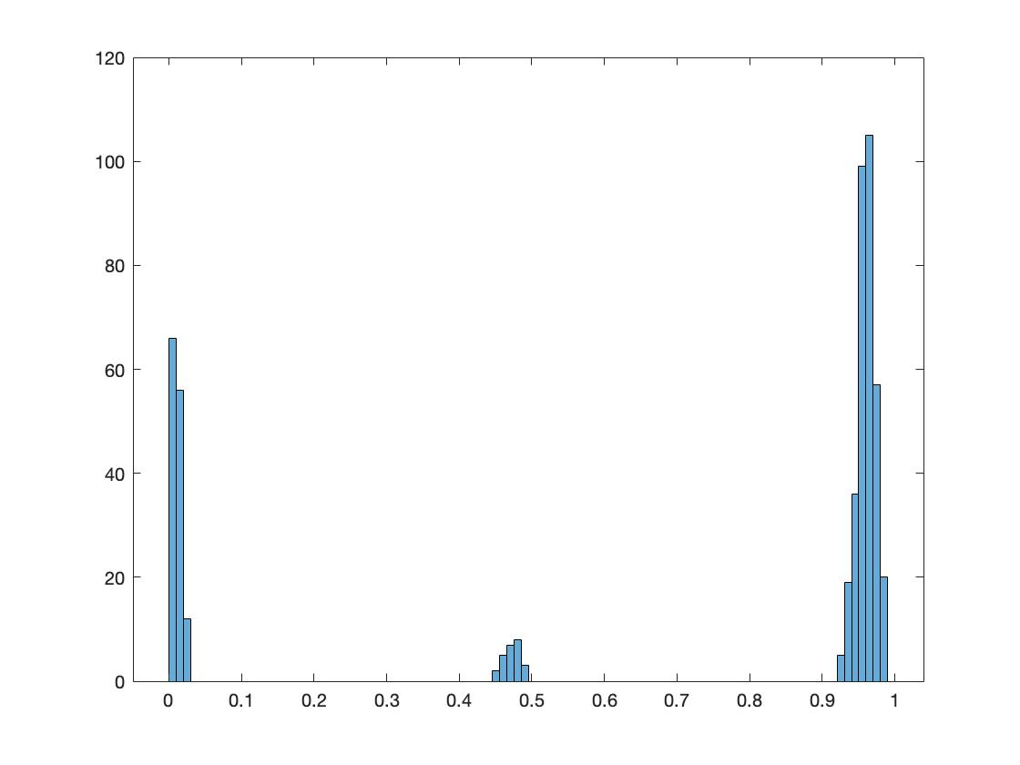
Proportion of Cells On at Steady State
Gaussian Activation Threshold
Exponential Activation Threshold
Counts
Counts
Proportion in “On” State
Proportion in “On” State

Slide 7


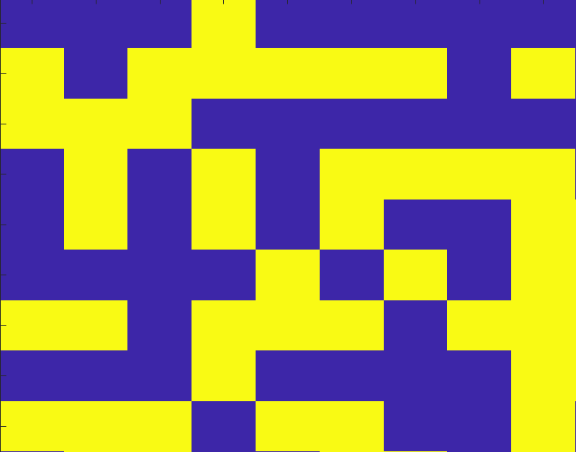
Quantification of Spatial Patterns
Some observed steady states of the model:
All cells off
All cells on
Random on/off
Circular on/off gradient
Non-random patterns

Slide 8
Quantification of Spatial Patterns
Proposal: Study the angular dependance of on/off patterns at fixed radii from central cell
At each r: constant value = 0
At each r: constant value = 1
At each r:
Random fluctuations
At small r: value = 1
At large r: value = 0
Central Cell
- How to quantify angular dependance?
Maybe Fourier analysis or some type of correlation
- This quantifies interplay between geometry and randomness in activation threshold.
Complex, but ordered fluctuations

Slide 9
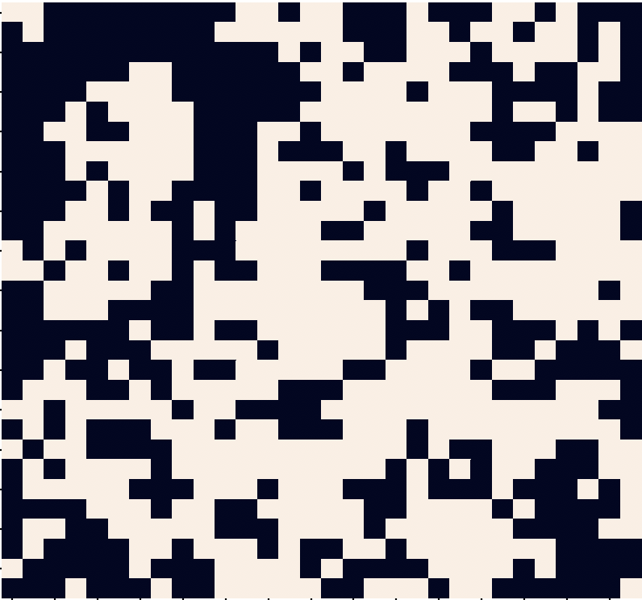
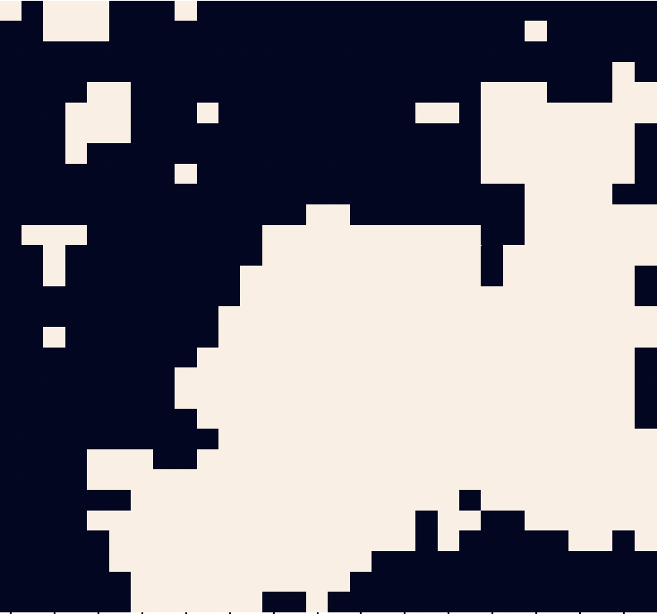
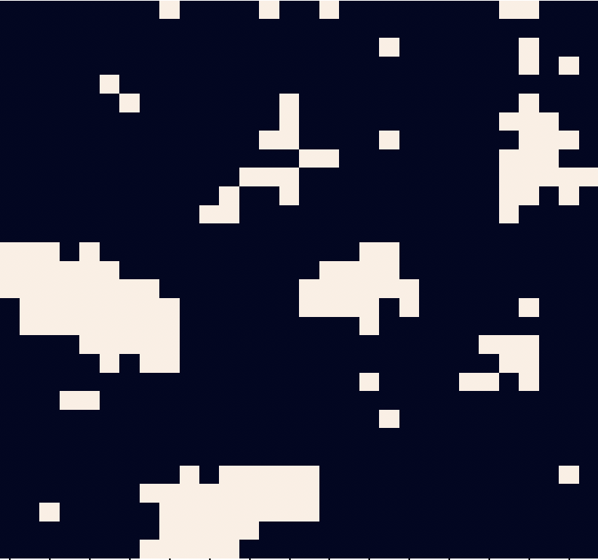
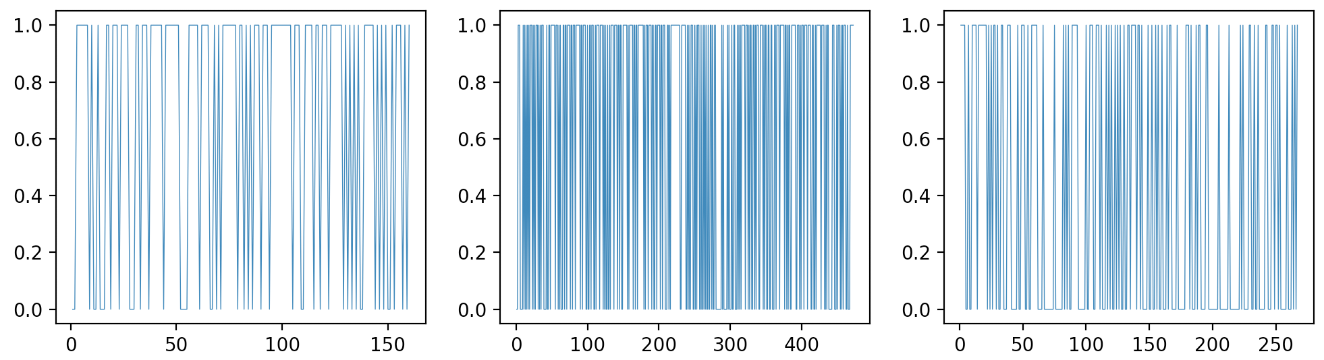
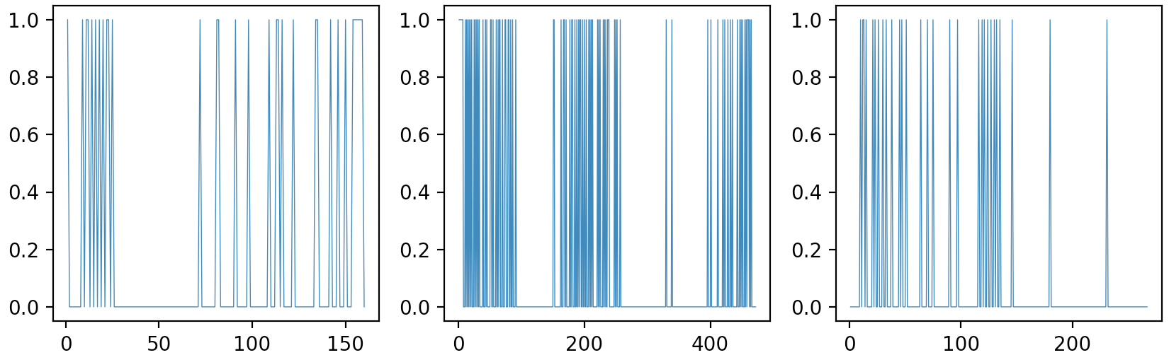
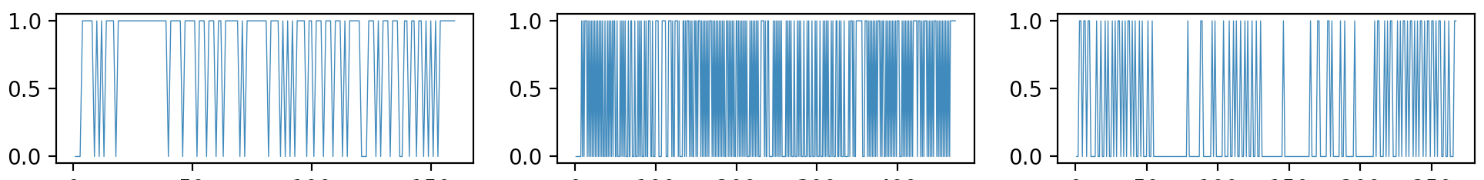
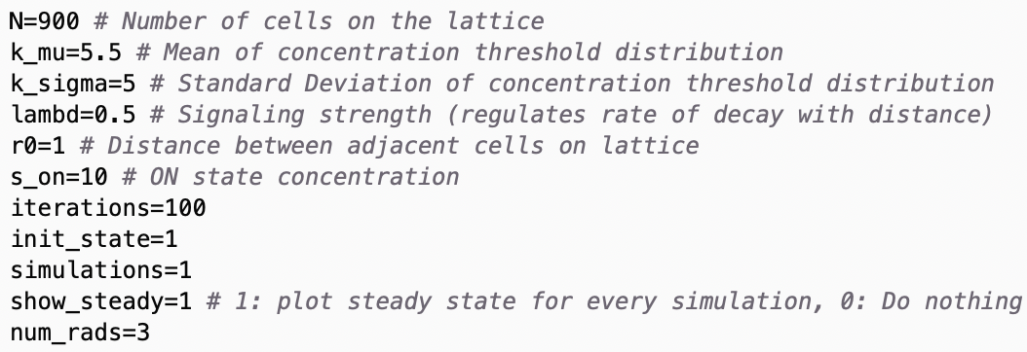
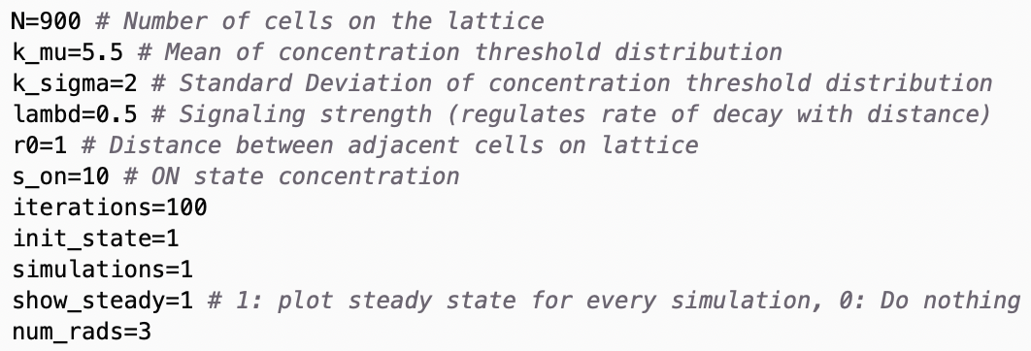
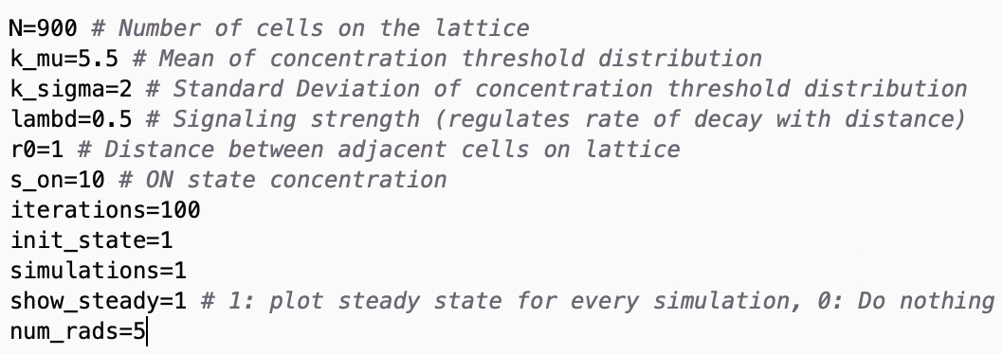
Quantification of Spatial Patterns
Some examples:

Slide 10
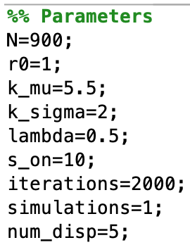
Trajectory
- Ran model for 2000 iterations

Slide 11
Trajectory
- Ran model for 2000 iterations

Slide 12
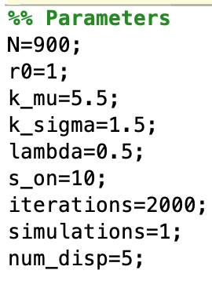
Trajectory
- Ran model for 2000 iterations

Slide 13
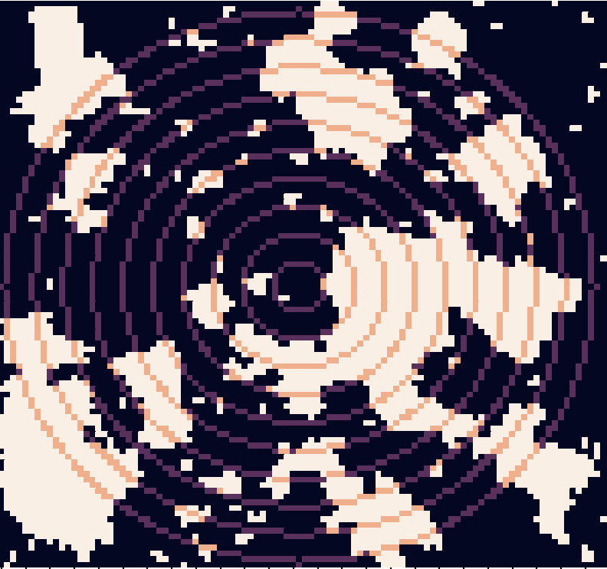
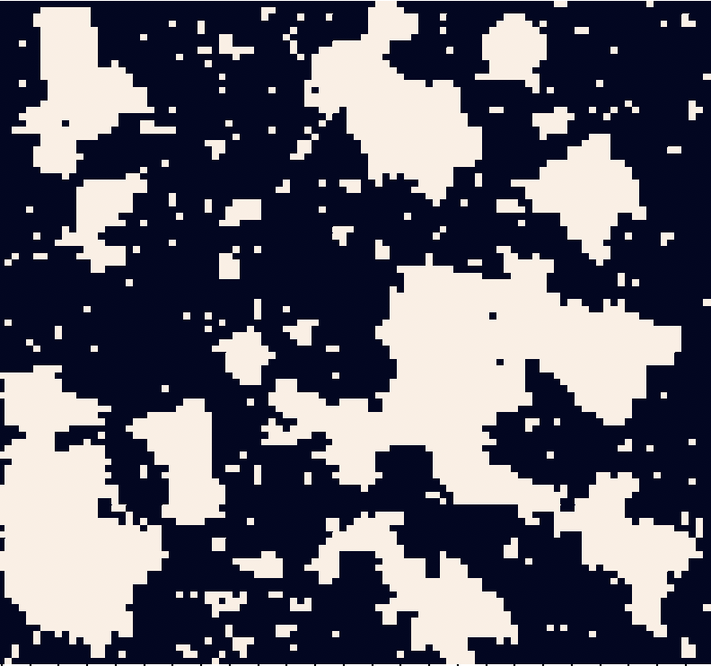
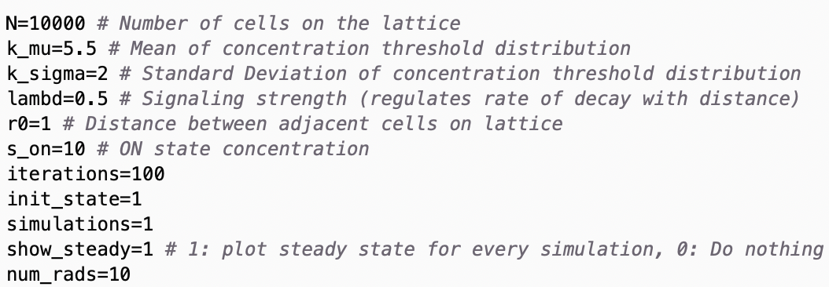
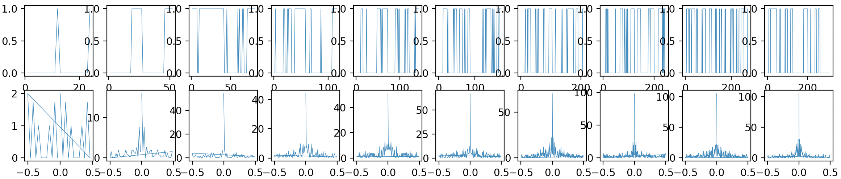
Quantification of Spatial Patterns

Slide 14

Homologous Structural Patterns Repeat at Various Length Scales
Structural patterns with complex shapes repeat themselves at different length scales
How to quantify? Problem is that each component is arbitrarily oriented
Need a measure that is scale and rotationally-invariant
In this example: “U-shape” repeats

Slide 15
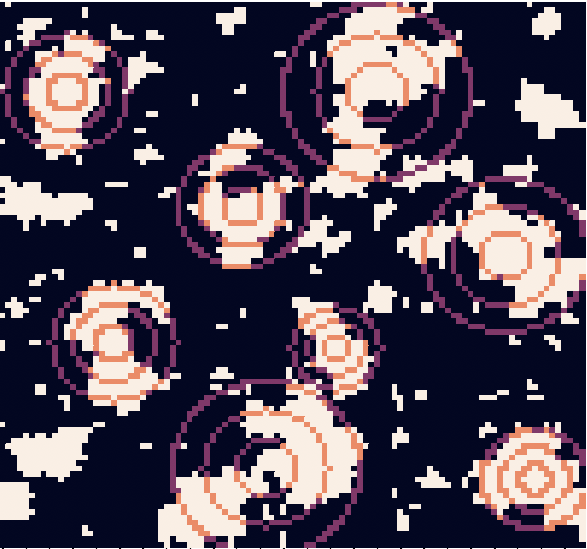
Homologous Structural Patterns Repeat at Various Length Scales
Utilize previous measure, but at a component-level, not system-level
Proposed measure: 1) Binarize frequency spectrum of each circle with threshold, 2) take mean over spectrum, 3) take mean over all circles
Threshold:
Compute proportion of sampled frequencies above threshold

Slide 16
Homologous Structural Patterns Repeat at Various Length Scales

Slide 17
Comparison to Alternate Measures
Alpha Diversity: Assume population separated into distinct subunits – calculate mean diversity within each subunit
Beta Diversity: Ratio between diversity in entire system (Gamma Diversity) and mean diversity within subunits
Doesn’t account for spatial relationships between subunits
This measure depends on scale of subunits
Teich et. Al Paper: Measure captures nearest neighbor similarity of voxels

Slide 18
Quantifying “Communication Networks”
Condition for cell i to be in “ON” state
i
i
Edge connection criterion for connecting node i to node j
Depends on state of the rest of the population: fix to a constant value
i
j
How strongly does the state of node j influence the state of node i?
Repeat for all nodes

Slide 19
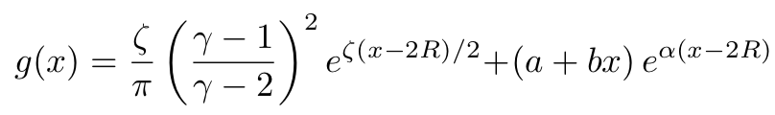
Analytic estimation of network parameters
If the distribution of K is specified, can we analytically estimate statistics of the network it forms, i.e. degree distribution?
In general maybe not.
Can we determine a specific form for the distribution that will allow for analytic study?
1) K is a random variable, 2) assume we can treat r as a random variable that depends on the geometry of the lattice
*
Can we approximate this network as a geometric network in which the distribution of “lengths” between nodes is given by the convolution of K and R?
Assume Hyperbolic geometry
Deconvolve g(x) to retrieve form for K

